Slide 1
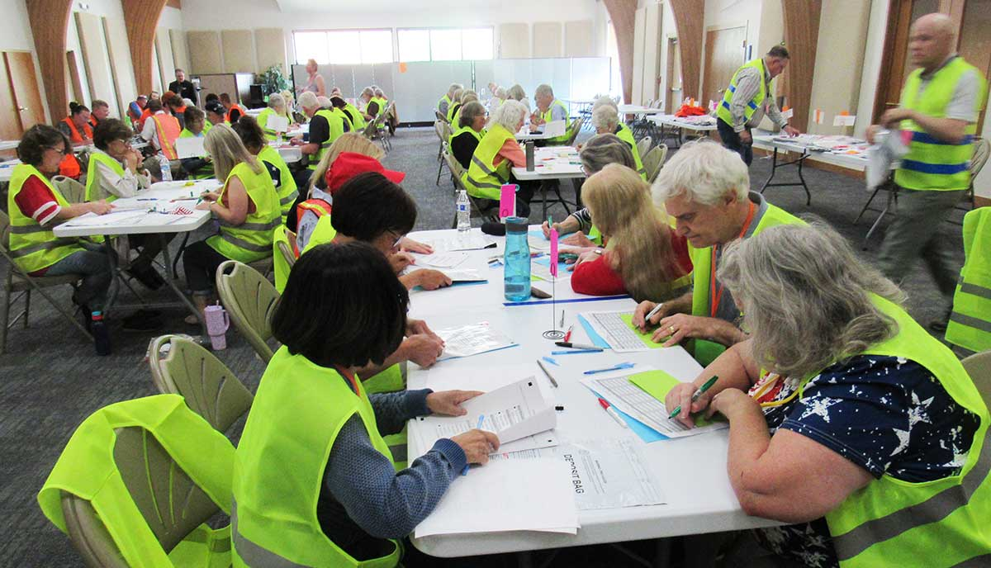
Rocky Mountain Method
Hand Count Training

Slide 2
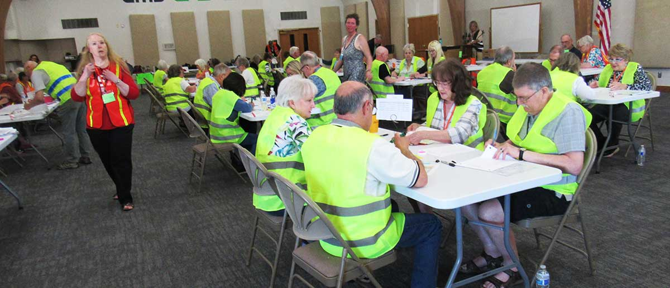
Three Steps of Hand Counting
Batching (make groups of 25 ballots)
Tallying (count the votes from one batch)
Aggregating (total the tally totals)
Notes:
Batching, tallying, and aggregating are just fancy names for grouping the ballots, counting all the votes in each group of ballots, and adding up the total votes from all the groups.
If there are more than about 600 ballots, it won’t fit on one aggregation sheet and there will be a second level of aggregation to total the aggregation totals.

Slide 3
How Many People Do You Need?
Minimum team of 4 (can handle about 300 ballots on Election Night)
Overall formula:
People = ballots/(12 * hours)
Or,
Ballots = 12 * people * hours
Or,
Hours = ballots/(12 * people)
This many people | Can count this many ballots | In this many hours
4 | 120 | 2.5
5 | 300 | 5
10 | 600 | 5
70 | 4248 | 5 (tested 5/16/26)
144 | 1800 | 1 (tested 4/6/24)
Notes:
On average, one person can handle 12 ballots per hour, but you can’t do it with just one person. The basic team is 4 people, but plan on 5 so you have a spare. Speed depends on many factors, including ballot size and complexity. A general estimate is that 4-5 people should be able to hand count 300 ballots in the five hours between 7pm and midnight of Election Night.
But if you have more ballots or need to go faster, just scale up to a team of 10, 20, or 144. Here is the same formula three different ways, depending on whether you are trying to figure out how many people you need, how many hours you have to do it in, or how many ballots you can handle.
This method was tested with a large team counting ballots from state party assemblies in 2024 and 2026, and the timing came out very close to the estimate. The actual time for the team of 144 was 45 minutes, but the ballots were very simple. The team of 70 counted two sets of over 2000 ballots, finishing almost exactly at five hours, including some break time, which you should certainly allow for.

Slide 4
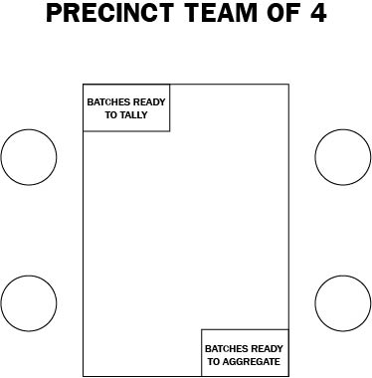
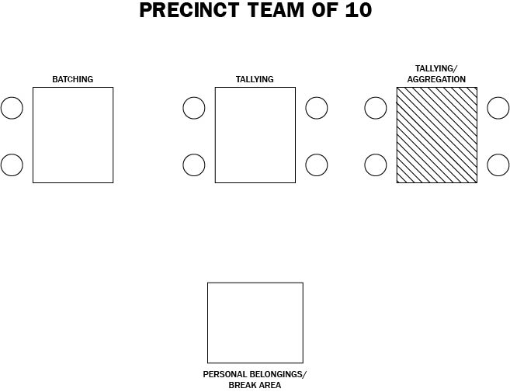
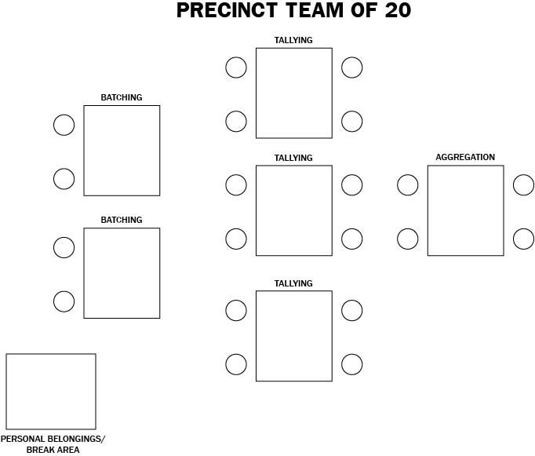
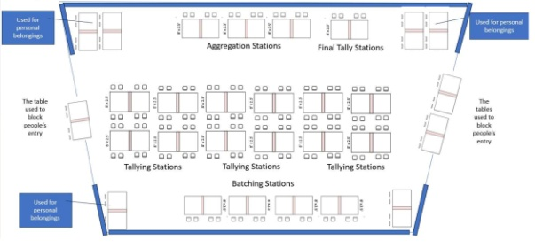
Where do you put them?
TEAM OF 144
Notes:
The basic team of four can do batching, tallying, and aggregation at the same table if necessary. The team of 10 would batch at one table, then the other two tables would be tallying until the tallying is done and one of the tables becomes the aggregation table. The team of 20 would be working fast enough aggregation might start before batching is over, so you have a separate space for each step. And the team of 144 included 24 tally teams, so it was a serious setup where batches were moved between the steps by runners, and the tally teams raised flags to summon a runner.

Slide 5
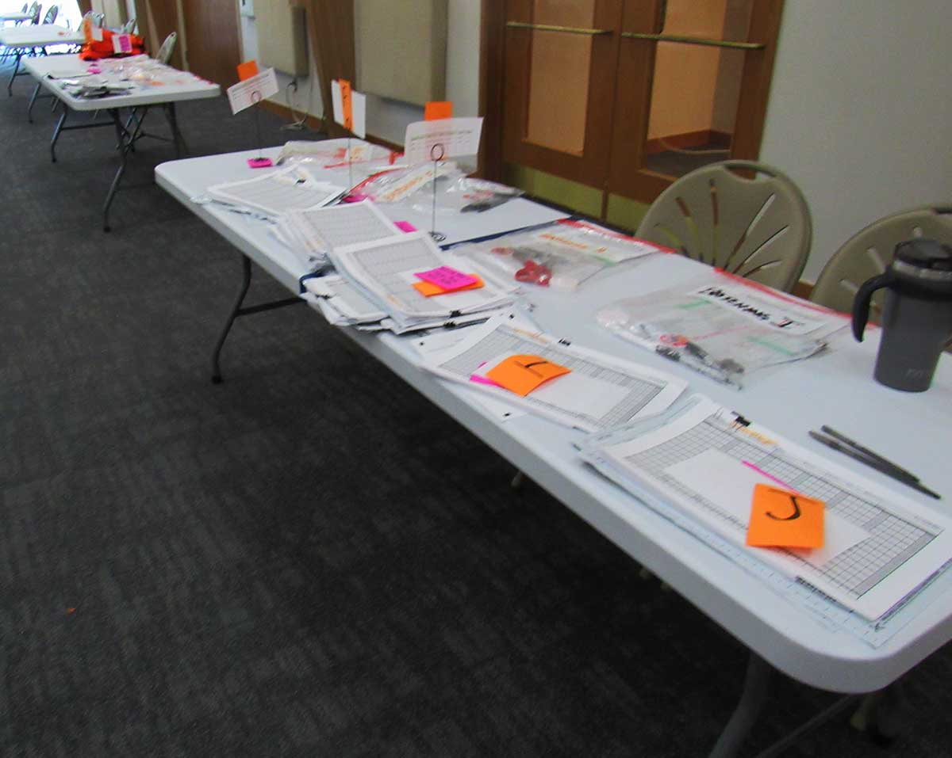
Batching
Team of two: one counts, other checks the count
Assemble a package of ballots, tally sheets, and (formal elections) ballot bag
(Formal elections) Track batches by recording batch number information on tally sheets, bag, and batch list
May do other tasks such as checking for overvotes and spoiled ballots
Approximately 1000 batched ballots waiting to be tallied
Notes:
The main job of batchers is to count out ballots into batches. Each batch usually has 25 ballots, but the last batch will probably have fewer. Both batchers should count the batch for themselves. When they agree on the count, they clip the ballots together with two tally sheets and, for formal elections, a tamper-indicating clear plastic bag. In a formal election batchers start the chain of custody record by filling in information on the tally sheet such as which ballot box the ballots came from, which batch team counted it, and the batch number. They may also record this information on the batch bag and on a batch number sheet. All this information tracks chain of custody to show who touched the ballots at every point in the process.
The tallying can’t start until the batching is done, so sometimes the batching will be kept as simple as possible so as to move on to tallying. But the batching is also the quickest step, so sometimes it makes more sense to have the batchers check for any complications such as overvotes (too many votes in one race) and spoiled ballots (ballots which can’t or shouldn’t be counted because they are unreadable, unusable, or filled out in error). Batchers will be told what to do with any problems they find.

Slide 6
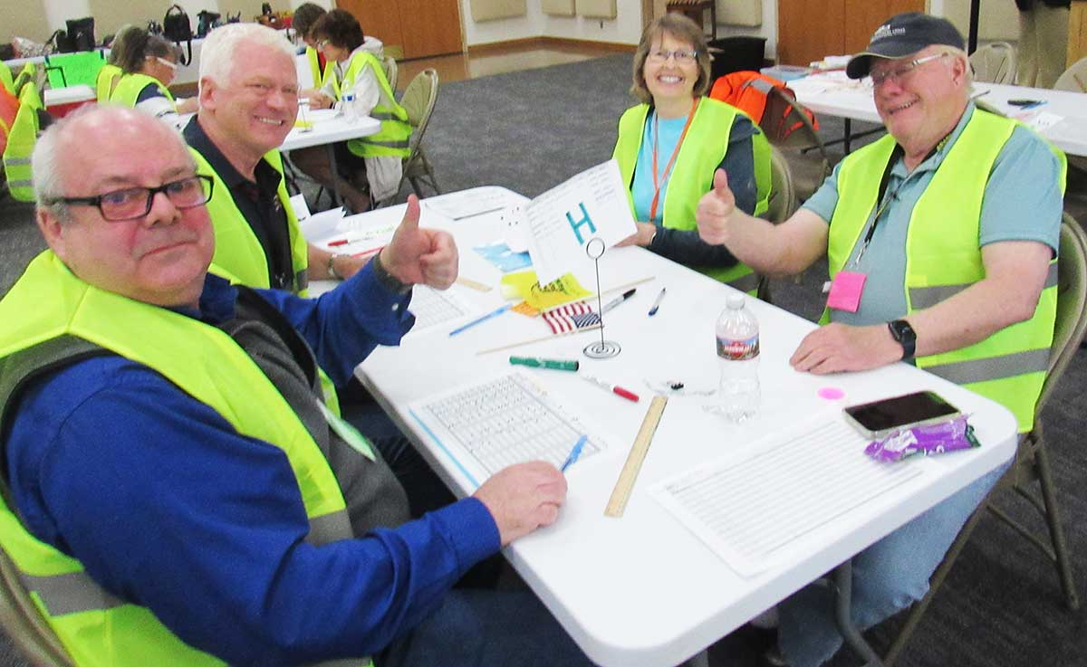
Tallying
Team of four
  Caller
  Watcher
  Tally 1
  Tally 2
Record all the votes from one batch of ballots on the tally sheets, and total the votes from the batch.

Slide 7
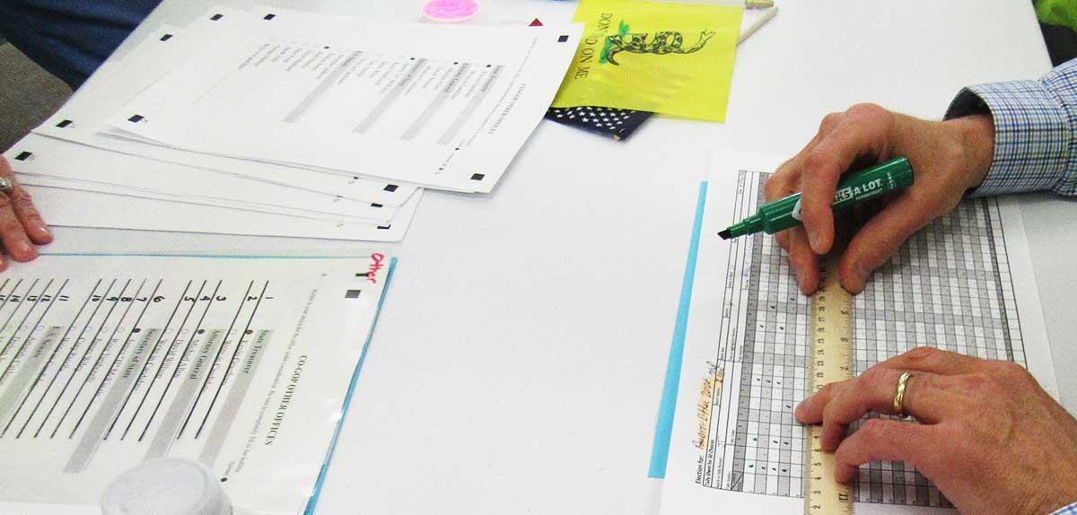
Tally Caller and Watcher
Caller reads the numbers from each ballot with votes by them: “1, 3, 6, 18”
Watcher observes the ballot and corrects any mistakes, then stacks the ballots in order
Notes:
Depending on the election, Watchers may or may not be allowed to write numbers on the ballots. A good practice either way is to stack the ballots in bunches of five, crosswise to each other, which makes it easier to find the right ballot if the talliers have a question later about one of them.

Slide 8
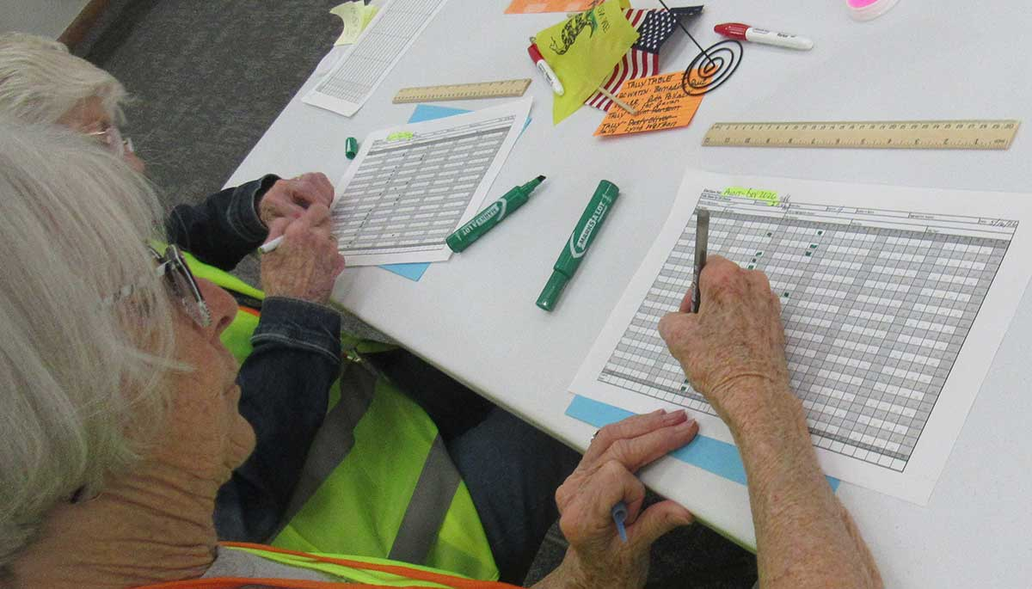
Tally 1 and Tally 2
Mark votes on the tally sheet, one line per ballot
At the end of the batch, total the votes at the bottom of each column
Check that totals agree with each other
Resolve any differences
(Formal election) Fill out chain-of-custody information
Talliers duplicate each other’s work as a double-check on every step.

Slide 9
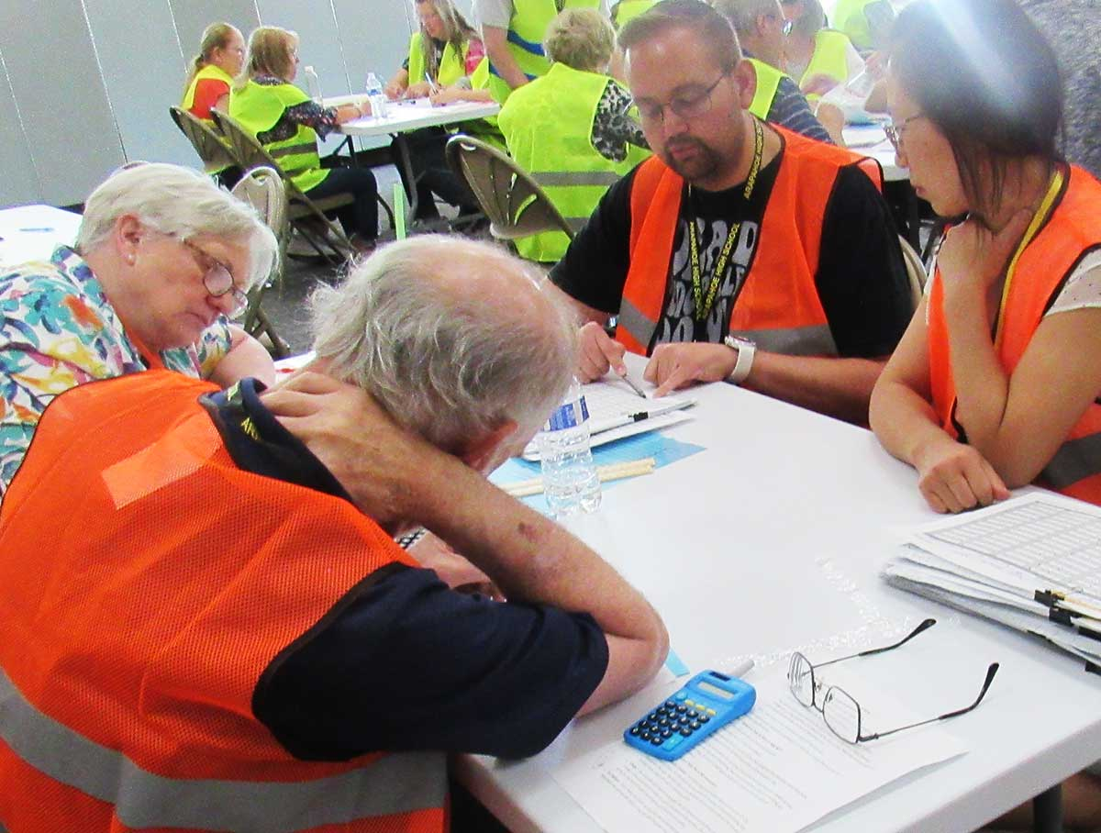
Aggregating
Team of four
  Caller
  Watcher
  Agg 1
  Agg 2
Record all the totals from each batch’s tally sheets on the aggregation sheets, then total the totals.
Notes:
Most people use calculators when totaling the column totals in aggregation, as it can involve adding some large numbers. Calculators do not cause a problem with transparency, because the numbers are visible to anyone and can be checked by anyone with a calculator, abacus, or mental math.

Slide 10
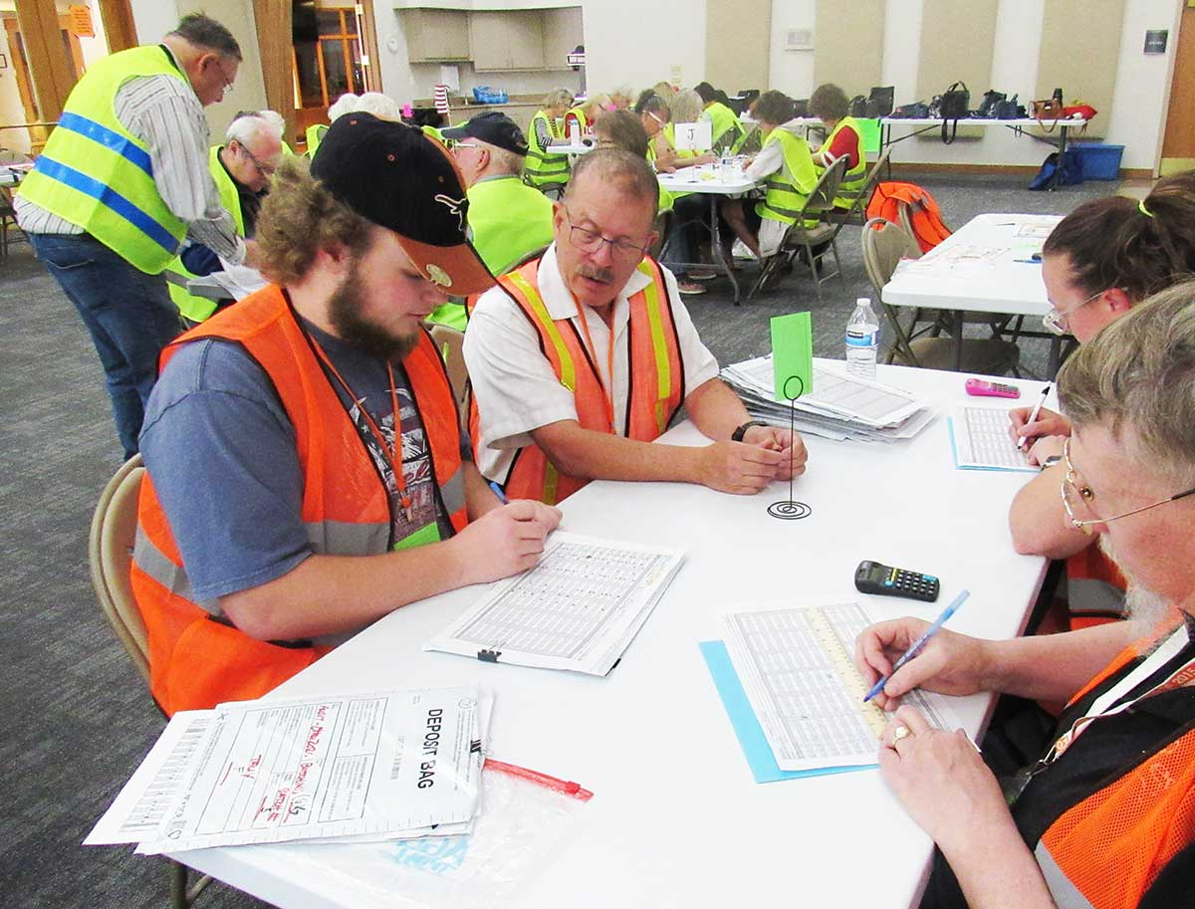
Aggregation Caller and Watcher
For each batch, Caller reads the totals from the bottom of a tally sheet
Watcher watches the tally sheet to correct any mistakes, and/or compares the bottom of the other tally sheet

Slide 11
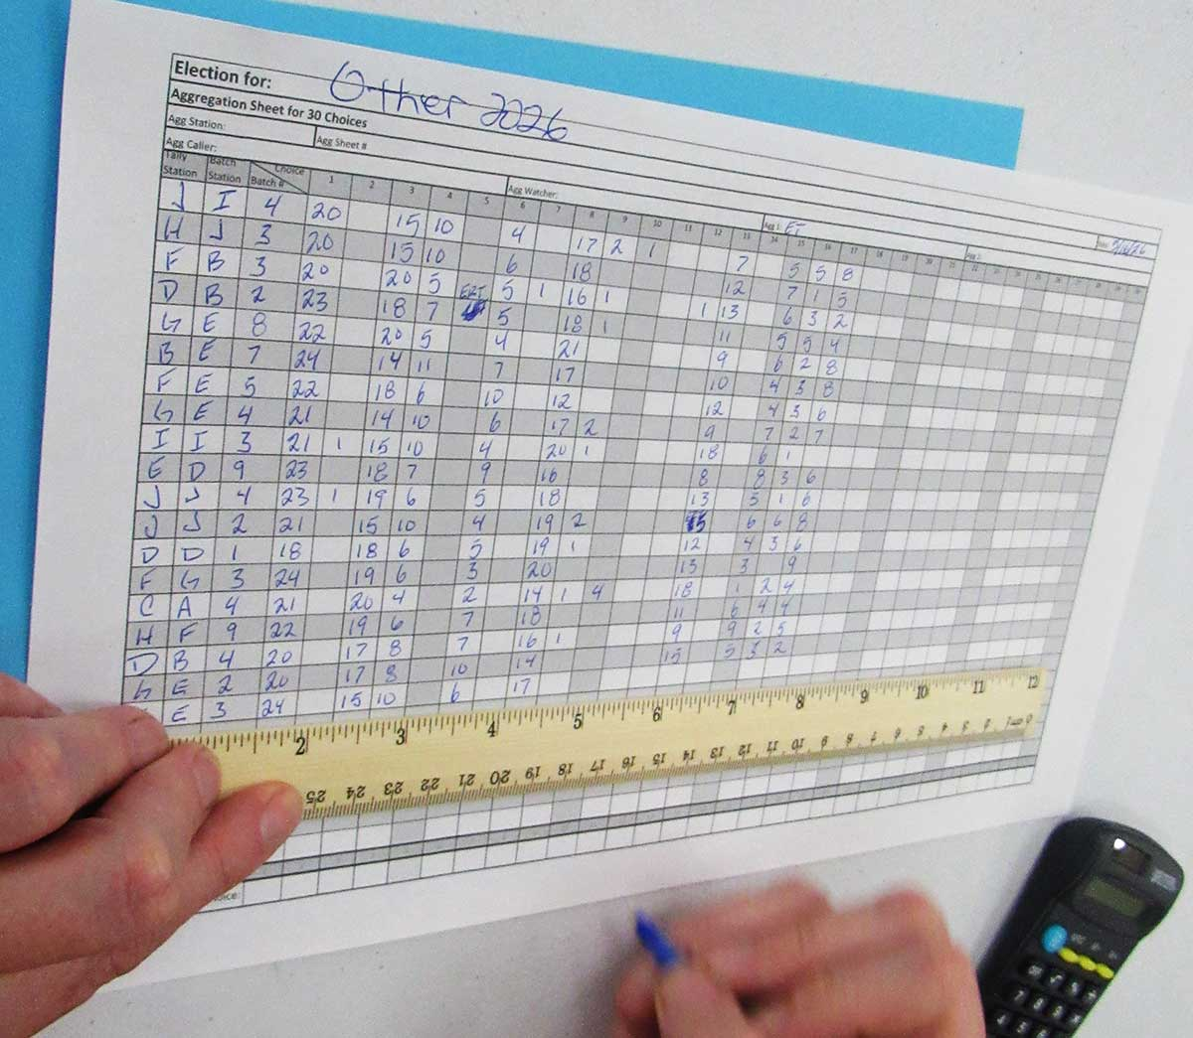
Agg 1 and Agg 2
Write totals on the aggregation sheet, one line per batch
At the end of the batches, total the totals at the bottom of each column
Check that totals agree with each other
Resolve any differences
(Formal election) Fill out chain-of-custody information
Agg 1 and Agg 2 duplicate each other’s work as a double-check on every step.

Slide 12
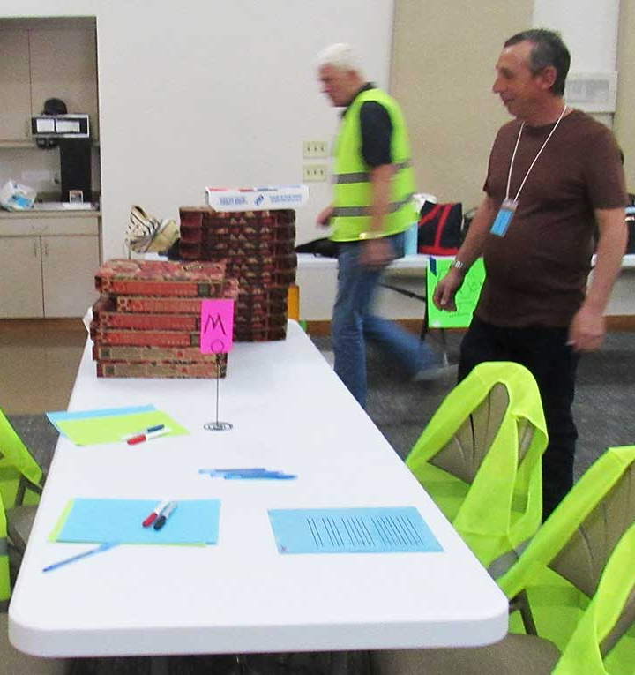
The End!
You now have a
Final
Auditable
Double-checked
physical record of results!
Now take care of the batches of pizza!

